Slide 1
LASHER DIVERSITY DAY
October 10, 2023

Slide 2
Upcoming fall holidays

Slide 3
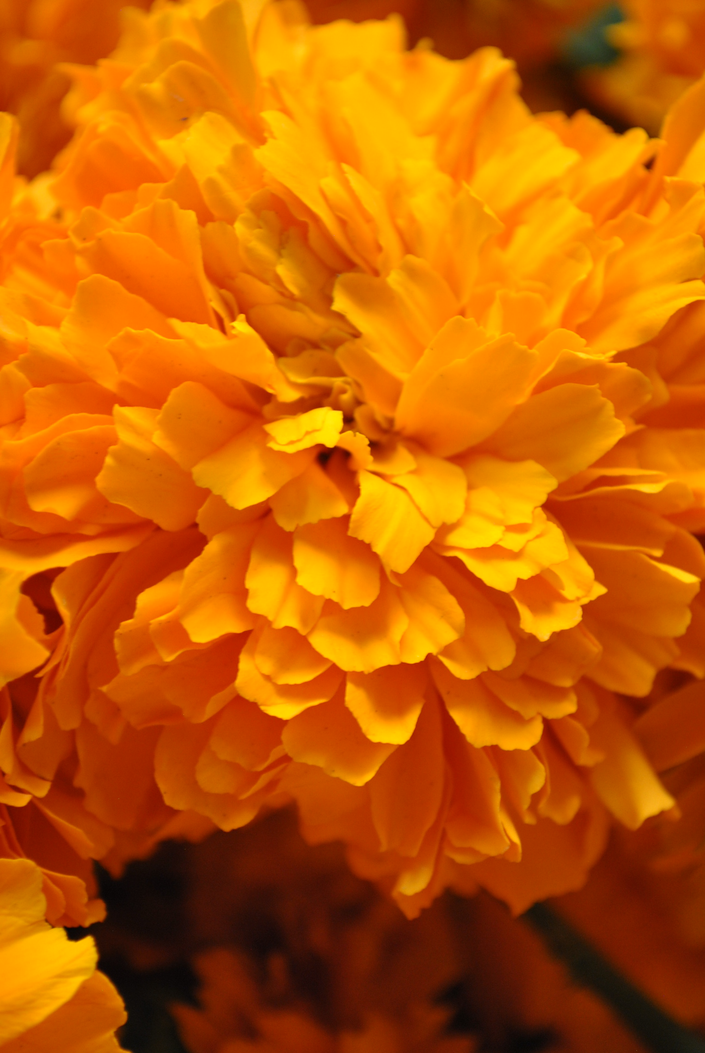
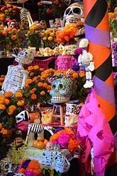
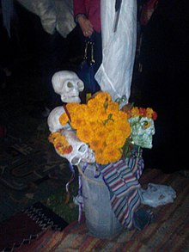
Día de los Muertos:
Celebrated on November 1st ​and 2nd .
Widely observed in Mexico.
Joyful time to celebrate family and friends who have passed on to the afterlife.
Families build ofrendas containing the favorite foods, beverages, and photos of the departed.

Slide 4
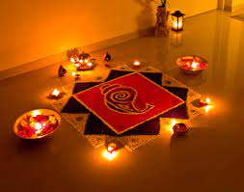
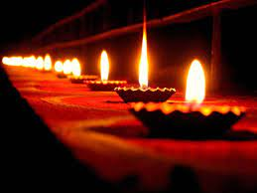
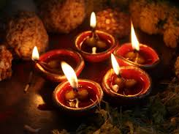
Diwali:
Celebrated on November 12^{th.}
Date of holiday is set to coincide with the new moon after the Fall harvest.
Indian holiday which celebrates the victory of light over darkness, good over evil, and knowledge over ignorance.
Observed broadly across religions in India by Sikhs, Hindus, Jains, and Buddhists.
5-day celebration where people clean their homes and shop for gold to bring them good luck in the coming year.
Individuals light their homes with diyas (oil lamps), candles and lanterns to chase out darkness and design elaborate rangolis.

Slide 5
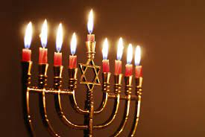
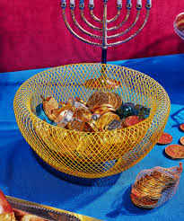
Hanukkah:
December 7-15, 2023.
Jewish festival of lights over an 8-day celebration which is observed by lighting 9 candles on a menorah.
To celebrate the ancient miracle of the oil burning a candle for eight nights, Jews celebrating Hanukkah light a candleholder called a menorah for eight nights.
Celebrates the rededication of the Hebrew Temple.
Holiday follows lunar cycle and is on a different date each year.

Slide 6
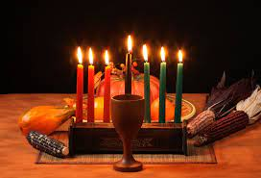
Kwanza:
December 26, 2023 – January 1, 2024.
African-American Holiday culminating on a communal feast on the sixth day.
Created in 1966 by Maulana Ron Karenga, Kwanzaa is an African American and Pan-African holiday that celebrates history, values, family, community and culture.

Slide 7
Holidays celebrated by lasherites

Slide 8
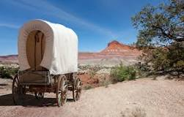
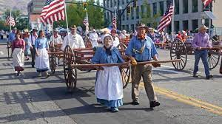
Pioneer Day:
July 24th
Pioneer Day is a state holiday in Utah and (according to Shannon) is a bigger day than the 4th of July in Salt Lake City.
Commemorates the entry of Brigham Young and the first group of Mormon pioneers into Utah's Salt Lake Valley in 1847.
Celebrated by holding pageants, parades, reenactments of the trek west, and other pioneer themed activities.

Slide 9
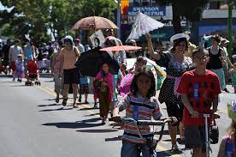
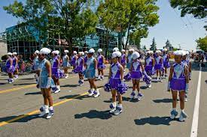
Wallingford Parade:
July 13, 2024.
2024 will be the 72nd year celebrating the Wallingford Parade.
Began as the only kiddie parade in the City of Seattle and has grown to include mini festivals and celebrates the community and neighborhood in Wallingford.
Carol recalls growing up in Seattle/Wallingford district where her family always participated in the parade. After the parade, Carol’s family would go home and barbeque chicken with neighborhood friends. Carol has brought BBQ drumettes to commemorate her Seattleite culture!

Slide 10
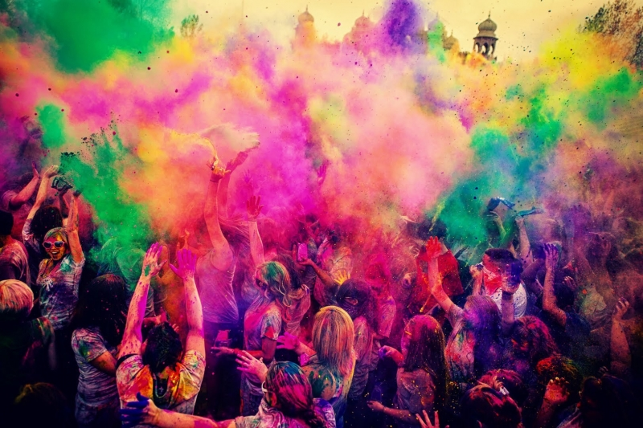
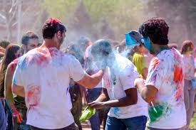
Holi:
Celebrates, colors, love and spring.
Originated and predominately celebrated in India and is celebrated by people through colored water and powders.
Celebrates agriculture and commemorated spring harvests.
The colors are believed to celebrate life and acknowledged the departure from winter which allowed for an abundant spring.

